Slide 1


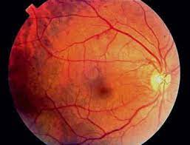
iHelp : Diabetic Retinopathy Detection
- by Team macBlockers

Slide 2
What is Diabetic Retinopathy?
Diabetic retinopathy is an eye condition that can cause vision loss and blindness in people who have diabetes. It affects blood vessels in the retina (the light-sensitive layer of tissue in the back of your eye).

Slide 3
Why do we care?
India is said to be the diabetic capital of the world by 2030 with over 80 million people affected by it.
If identified early, this is a blindness which can be avoided.

Slide 4
How are we caring?
Our web-app, ‘i-Help’ is an inexpensive and convenient alternative to costly equipment like OCT machines and Fundus image cameras.
This code can be implemented through regular eye scanners for an early detection of Diabetic Retinopathy, thus preventing possible permanent blindness due to diabetic complications.

Slide 5
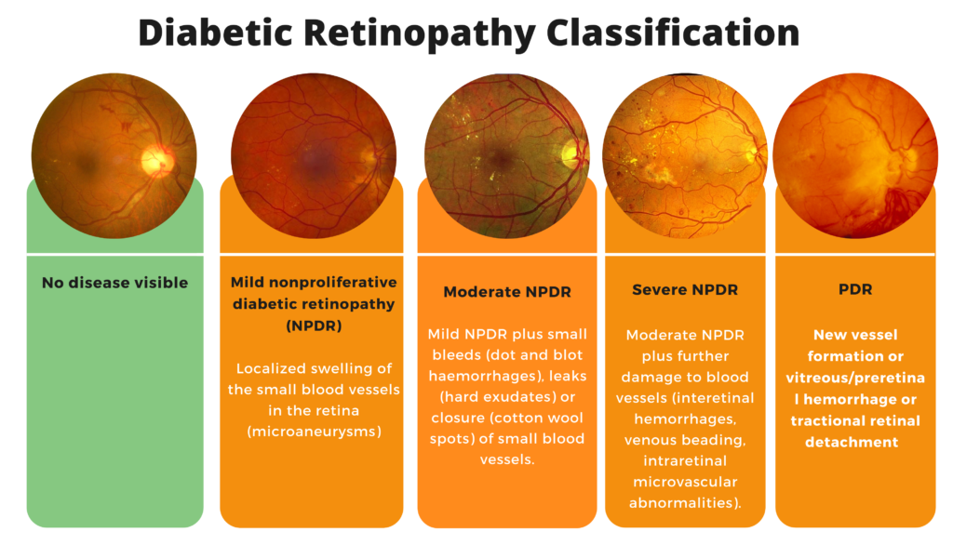

Slide 6
Our features :
Detection of Diabetic Retinopathy
Interactive UI-based web-app
A chatbot on our web-app for service assistance and ease of usage
Generated DR report is sent to patient’s email
Report is also backed up on our IPFS web3 storage
Shows location of nearest eye hospital

Slide 7

Technical Roadmap of the System
Build a Deep Learning Model
Gather datasets
Look at deployment strategies
Build a user interface
Utilise the new data to make the model better

Slide 8
Who is our product intended for?
For rural areas (Tier 4 cities) or small towns, which have small dispensaries and often lack the resources and expertise to detect DR.
A tool for doctors to prioritise cases based on the severity of the condition.
For anyone who wants to make healthcare affordable and accurate.

Slide 9





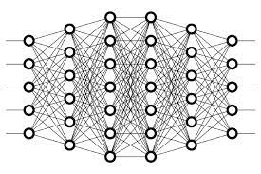


Tech stacks used :
TensorFlow
MongoDB
Flask
IPFS
Deep Learning
HTML
CSS
Moralis

Slide 10
Future scope :
Deploy on edge devices
Predict more than 5 stage diabetic retinopathy, like other biological conditions based on the retinal image.
Split Learning and Differential Privacy to preserve privacy.

Slide 11
THANK YOU !
Team members :
Nischith TN
Manik Gupta
Malvika Reddy
Niharikaa Bhattacharya

